Slide 1
The Data Link Layer
Chapter 3

Slide 2
Data Link Layer Design Issues
Network layer services
Framing
Error control
Flow control

Slide 3
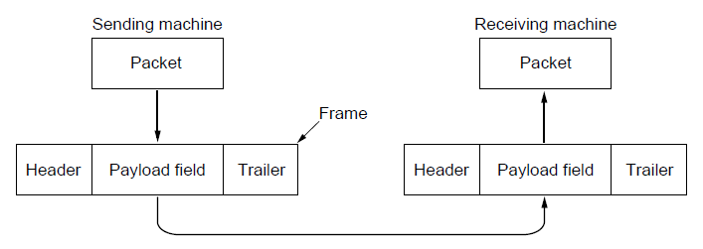
Packets and Frames
Relationship between packets and frames.

Slide 4
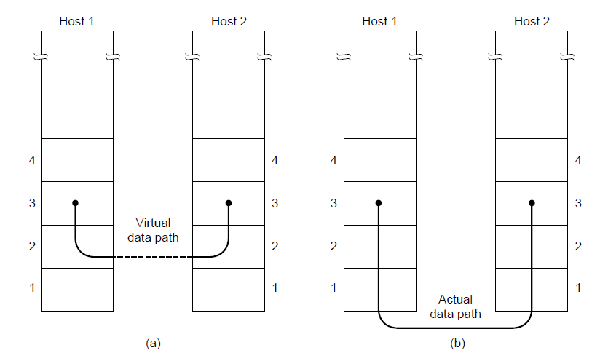
Network Layer Services
(a) Virtual communication. (b) Actual communication.

Slide 5
Possible Services Offered
Unacknowledged connectionless service.
Acknowledged connectionless service.
Acknowledged connection-oriented service.

Slide 6
Framing Methods
Byte count.
Flag bytes with byte stuffing.
Flag bits with bit stuffing.
Physical layer coding violations.

Slide 7
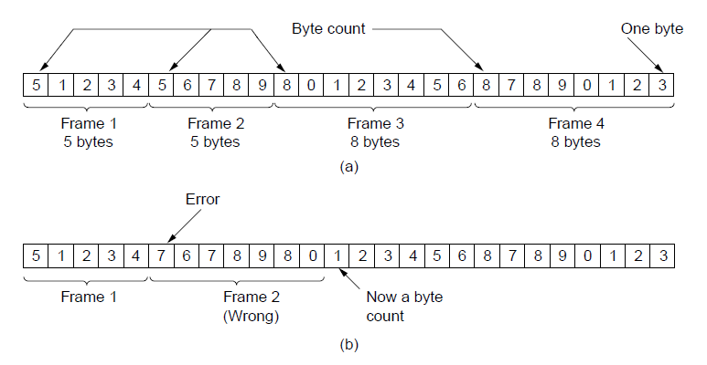
Framing (1)
A byte stream. (a) Without errors. (b) With one error.

Slide 8
Framing
Another solution: having each frame start and end with special bytes. Often the same byte called a flag byte.
It may happen that the flag byte occurs in the data!
One way to solve this to add a special byte (ESC) just before each ‘accidental’ flag byte in the data. It is called byte stuffing.
What if an escape byte occurs in the data?

Slide 9
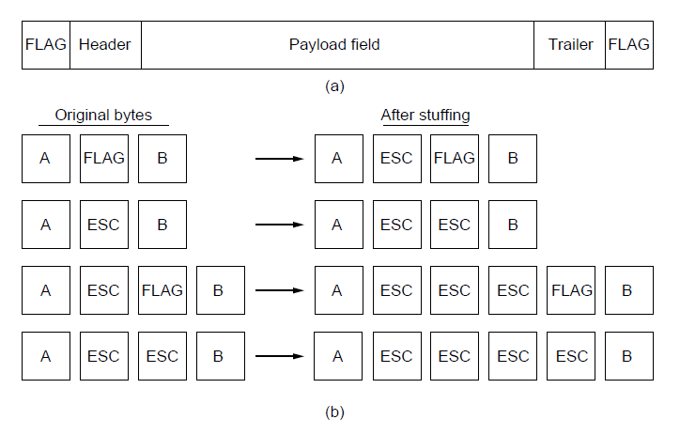
Framing (2)
A frame delimited by flag bytes.
Four examples of byte sequences before and after byte stuffing.

Slide 10
Framing
Another technique is bit stuffing which is similar to byte stuffing.
Let’s say flag byte patten is 01111110.
Whenever the sender’s data link layer encounters five consecutive 1s in the data, it automatically stuffs a 0 bit into the outgoing bit stream.

Slide 11
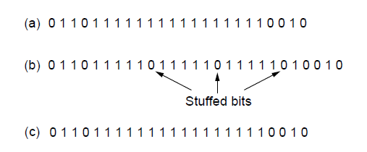
Framing (3)
Bit stuffing. (a) The original data. (b) The data as they appear on
the line. (c) The data as they are stored in the receiver’s memory after destuffing.

Slide 12
Error Detection and Correction

Slide 13
Two Basic Strategies for Dealing with Error
Error-Correcting
Error-Detecting
  Check for error at the receiver
  Error: Request a retransmission
  No error: Either continue or send an ACK
Both add redundant information to the data sent.

Slide 14
Two Basic Strategies for Dealing with Error
Error-Correcting codes --- on the highly reliable channels.
Error-Detecting codes --- on channels such as wireless links that make many errors.
What may cause errors?
  Deep fade on a wireless channel,
  Transient electrical interface on a wired channel,
  ...
What should be done with error bursts?

Slide 15
Error Correcting Codes (1)
Hamming codes.
Binary convolutional codes.
Reed-Solomon codes.
Low-Density Parity Check codes.

Slide 16
Error control codes
Adding redundancy to overcome errors
m message bits
r (redundant) check bits
n=m+r codeword bits
2^{m} messages
2^{n} possible codewords
code rate = m/n

Slide 17
Hamming distance
The two codewords have a Hamming distance of two (differ in two bits)
Hamming distance of the code: Minimum Hamming distance between any two codewords
2^{m}/2^{n} or 1 / 2^{r} of the possible messages will be legal

Slide 18
Error detection/correction capacity
Detect d errors: distance d+1 code
Correct d errors: distance 2d+1 code
Consider:
0000000000, 0000011111, 1111100000, 1111111111

Slide 19
Error correction/detection capacity
Consider:
0000000000, 0000011111, 1111100000, 1111111111
corrects double errors,
detects quadruple errors.

Slide 20
Error correction capacity
In order to design a code with m message bits and r checkbits that will allow all single errors to be corrected. We should have
(n+1)2^{m} <= 2^{n}
n= m + r
(m+r+1) <= 2^{r}
Given m it puts a limit on the number of checkbits required.

Slide 21
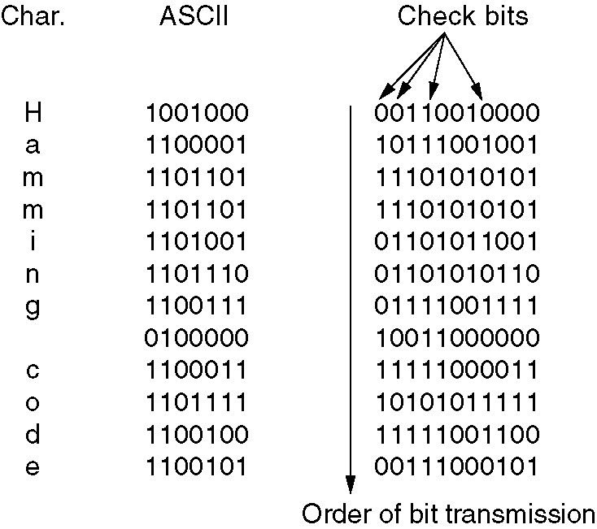
Error-Correcting Codes
Use of a Hamming code to correct burst errors.

Slide 22
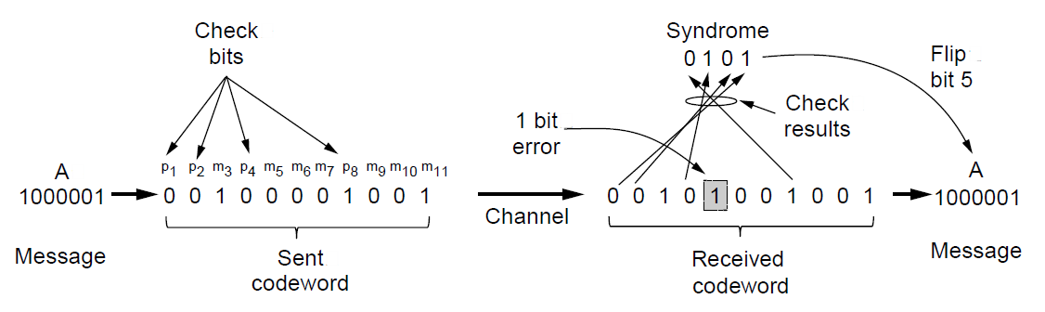
Error Detection Codes
Example of an (11, 7) Hamming code
correcting a single-bit error.

Slide 23
Error detecting codes
Parity codes
  Odd parity (tek eşlik)
    0/1 added to make the sum of 1’s equal to an odd number
  Even parity (çift eşlik)
    0/1 added to make the sum of 1’s equal to an even number

Slide 24
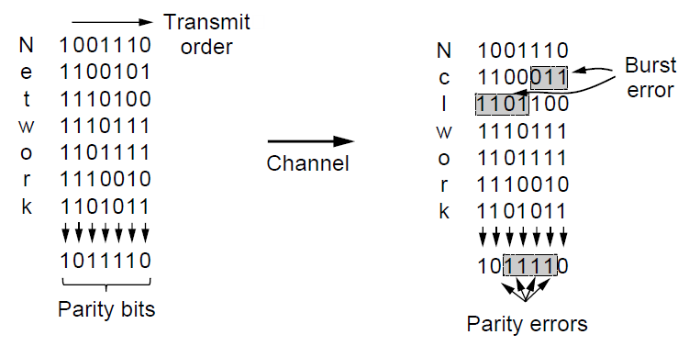
Error-Detecting Codes
Interleaving of parity bits to detect a burst error.

Slide 25
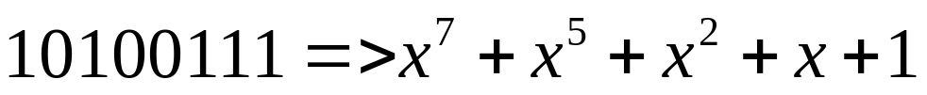
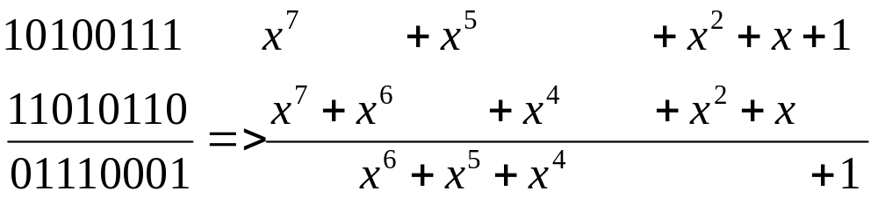
Error detecting codes Cyclic Redundancy Check (CRC )
Polynomial codes
Polynomial arithmetic is modulo 2.

Slide 26
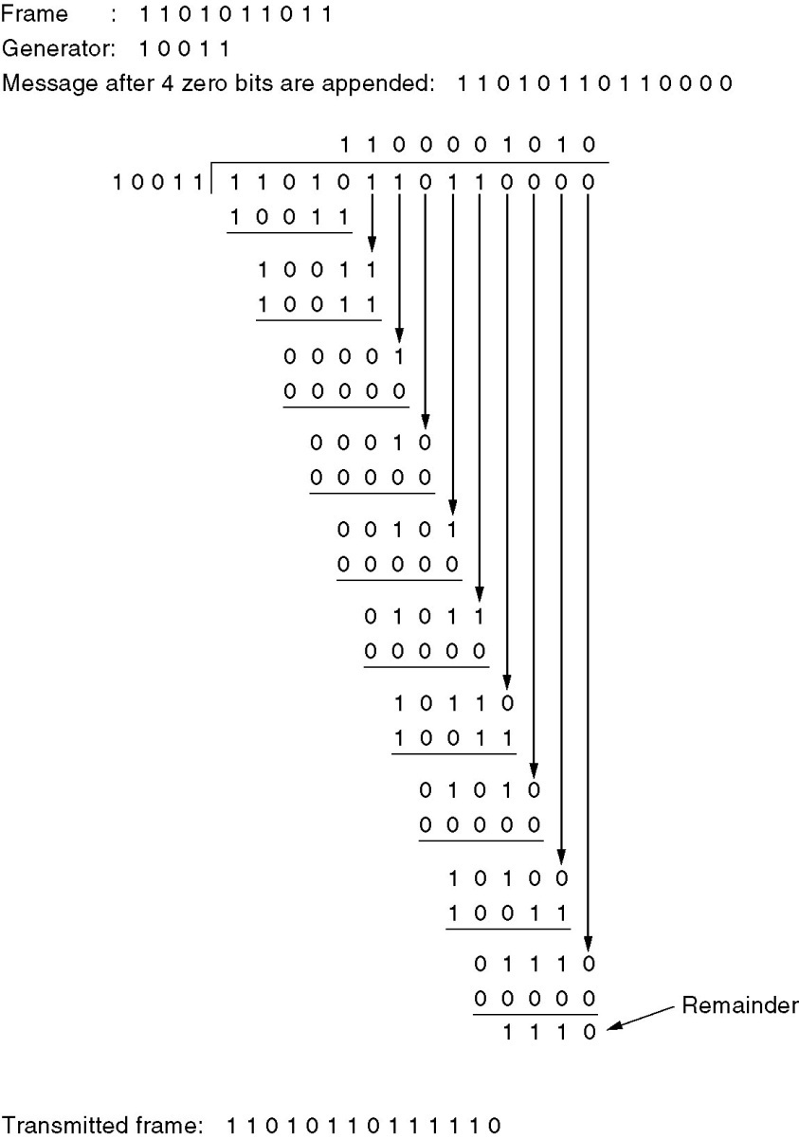
Error-Detecting Codes
Calculation of the polynomial code checksum.

Slide 27
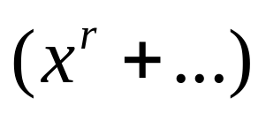
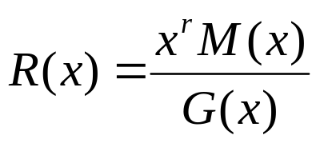


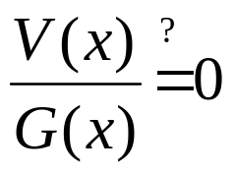
Cyclic Redundancy Check
(Çevrimli Fazlalık Sınaması)
M(x): message polynomial
G(x): generator polynomial available at transmitter and receiver of degree r
Transmitter operation:
  R(x): remainder
  T(x): transmitted
Channel effects
Receiver: check

Slide 28
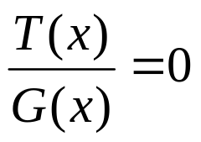
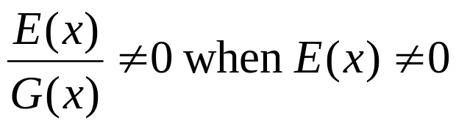
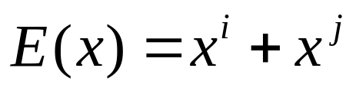
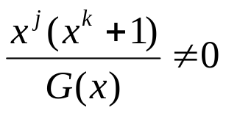

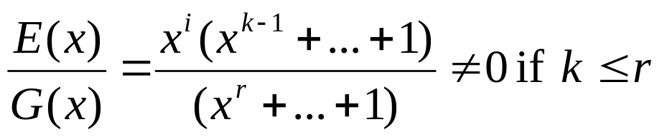
Cyclic Redundancy Check
(Çevrimli Fazlalık Sınaması)
Note that by definition
Can catch errors if
Design G(x) to
  catch single bit errors: if G(x) has two or more terms
  Catch double bit errors:
  catch odd number of errors:
  catch burst errors of
  length r:
No polynomial with an odd number o terms has x+1 as a factor in mod 2.

Slide 29
Elementary Data Link Protocols (1)
Utopian Simplex Protocol
Simplex Stop-and-Wait Protocol
  Error-Free Channel
Simplex Stop-and-Wait Protocol
  Noisy Channel

Slide 30
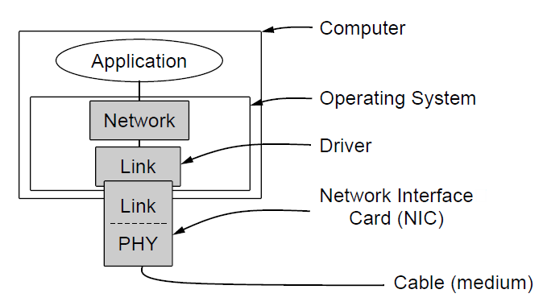
Elementary Data Link Protocols (2)
Implementation of the physical, data link, and network layers.

Slide 31
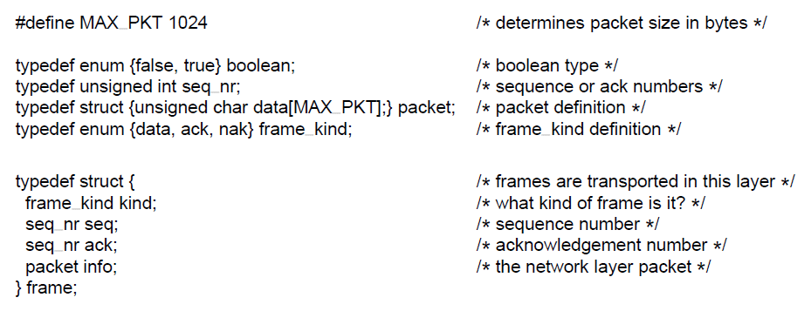
Elementary Data Link Protocols (3)
. . .
Some definitions needed in the protocols to follow. These definitions are located in the file protocol.h.

Slide 32
Fields of a frame
Kind
Sequence number (0 – MAXSEQ)
Ack
Info
First three forms the header

Slide 33
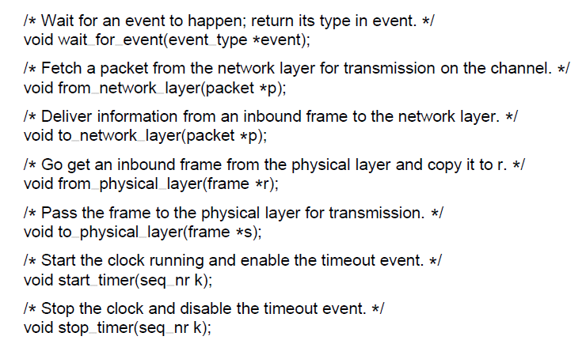
Elementary Data Link Protocols (4)
. . .
Some definitions needed in the protocols to follow. These definitions are located in the file protocol.h.

Slide 34
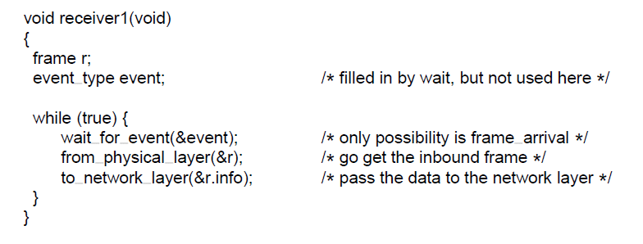
Utopian Simplex Protocol (2)
A utopian simplex protocol.

Slide 35
Do we need a signal from the receiver to continue?
Acknowledgement, ack in short.
How long should one wait for an ack to receive?

Slide 36
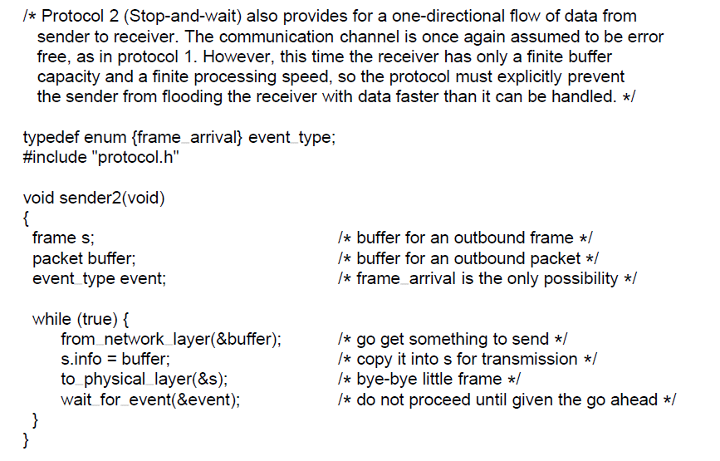
Simplex Stop-and-Wait Protocol for a Noisy Channel (1)
. . .
A simplex stop-and-wait protocol.

Slide 37
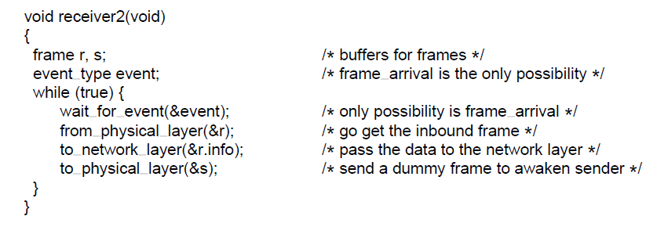
Simplex Stop-and-Wait Protocol for a Noisy Channel (2)
A simplex stop-and-wait protocol.

Slide 38
What may go wrong?
Packet could be lost
  Sender retransmits it not receiving the ack
What else?

Slide 39
Ack frame could be lost
  In case the ack gets lost to prevent duplicate frames at the receiver, the frame should contain a seq. no.

Slide 40
Sliding Window Protocols
Simplex to half duplex
  Piggybacking (sırtında taşıma)
    Delaying outgoing ack.s so that they can be hooked onto the next outgoing data frame
A One-Bit Sliding Window Protocol
A Protocol Using Go Back N
A Protocol Using Selective Repeat

Slide 41
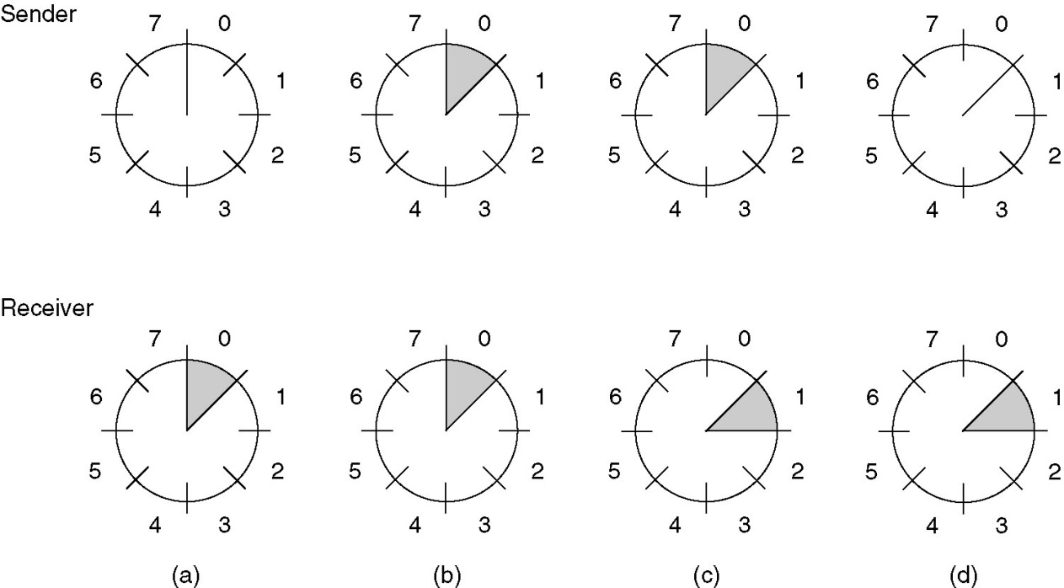
Sliding Window Protocols (2)
A sliding window of size 1, with a 3-bit sequence number.
(a) Initially.
(b) After the first frame has been sent.
(c) After the first frame has been received.
(d) After the first acknowledgement has been received.

Slide 42
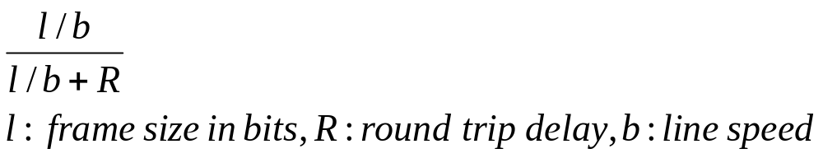
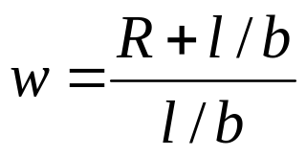
Sliding Window Protocols
Pipelining
Stop&Wait line utilization
Sending window size :
Book uses DB which is delay-bandwidth product . Follow the example in page 232.

Slide 43
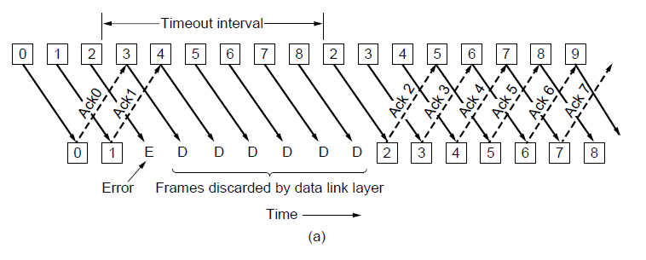
Protocol Using Go-Back-N
Pipelining and error recovery. Effect of an error when
(a) receiver’s window size is 1

Slide 44
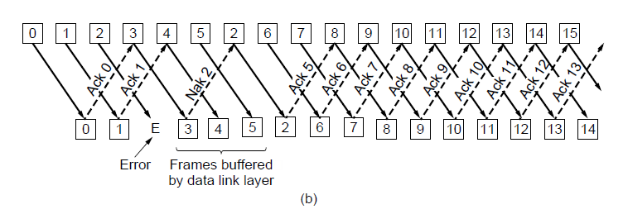
Protocol Using Go-Back-N
Pipelining and error recovery. Effect of an error when
(b) receiver’s window size is large.

Slide 45
Go-back-n
Study the scenario in page 235.
For this reason maximum number of outstanding frames must be MAX_SEQ.
Means 7 when 3 bits are used to number the frames.

Slide 46
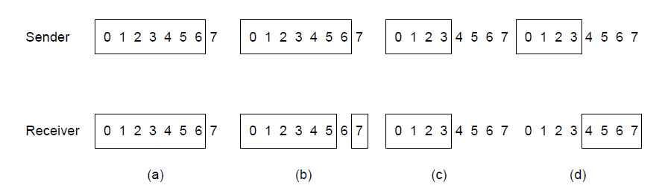
Protocol Using Selective Repeat
Initial situation with a window of size7
After 7 frames sent and received but not acknowledged.
Initial situation with a window size of 4.
After 4 frames sent and received but not acknowledged.

Slide 47
In order to solve such problems
window size= (MAX_SEQ + 1)/2

Slide 48
END
(CH3)

